Slide 1
AMG+: Extended Multilevel Principles Illustrated on the 1D Helmholtz Equation
Achi Brandt
Oren Livne
James Brannick
Karsten Kahl
The Multigrid Round Table
January 7, 2022

Slide 2
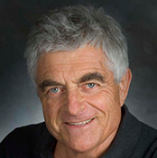
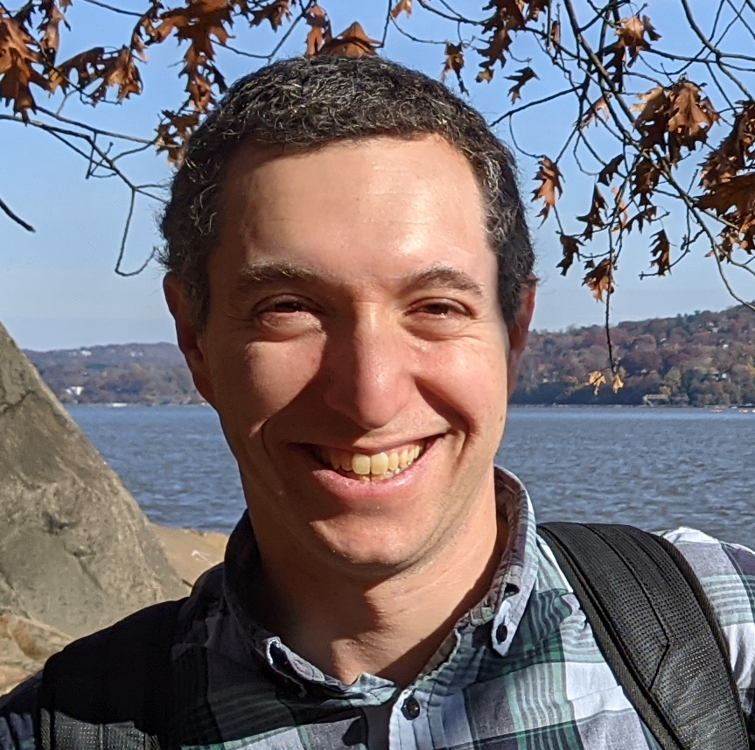
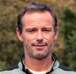
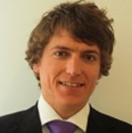
Team
Achi Brandt ACHIBR@GMAIL.COM
Weizmann Institute of Science
UCLA
Oren Livne OREN.LIVNE@GMAIL.COM
Educational Testing Service
James Brannick jjb23@psu.edu
PSU
Karsten Kahl kkahl@uni-wuppertal.de
University of Wuppertal

Slide 3
MOTIVATION
Make AMG work for many new problems

Slide 4
Principle (n.). a general scientific theorem or law that has numerous special applications across a wide field.
Notes:
We want to develop AMG to new specific problems, but in the process formulate generally useful principles that can apply to many new types of problems.

Slide 5
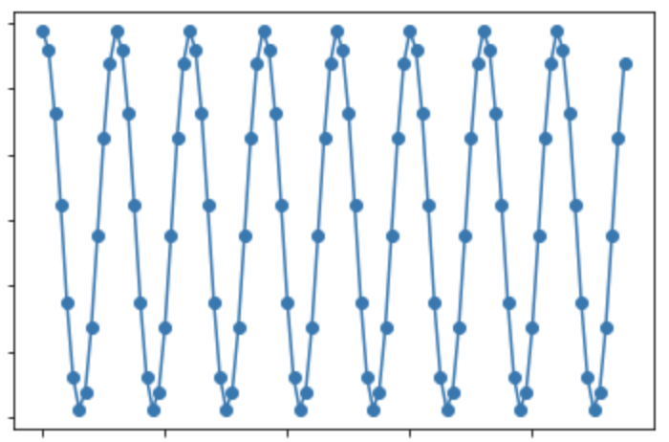



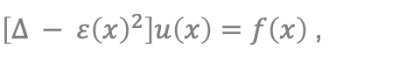






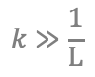

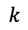
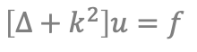



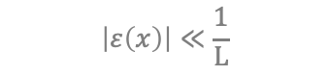



Challenging Problems for AMG
Nearly Singular
Systems
Species are not explicitly identified
Highly indefinite
Emerging types of coarse variables
$$\left|ε\left(x\right)\right|≪\frac{1}{\text{L}}$$
$\left[∆ − ε{\left(x\right)}^{2}\right]u\left(x\right)=f\left(x\right)$,
$$V$$
$$V$$
Stokes
$$U$$
$$P$$
$$U$$
$$P$$
$$U$$
$$V$$
$$V$$
$$U$$
$$P$$
$$U$$
$$P$$
$$U$$
$$V$$
$$V$$
$$\left[∆+k^{2}\right]u=f$$
$$k≫\frac{1}{\text{L}}$$
Multiple types: directional rays
$$k$$
5

Slide 6
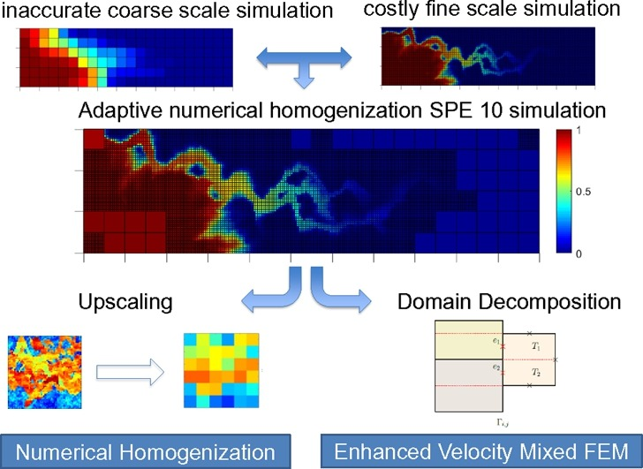
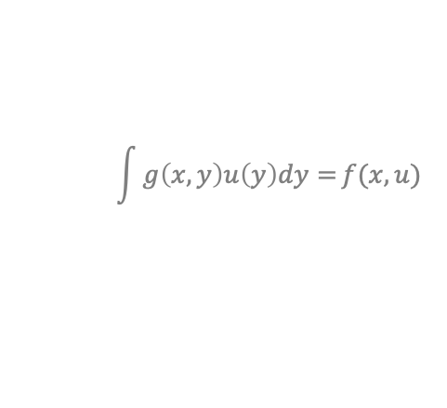
Challenging Problems for AMG (Cont.)
Upscaling
Deriving equations at increasingly coarser scale
Creating interpretable coarse-level variables
Non-linear systems
where a coarse version is not given
Inverse Problems
Non-local equations
Stochastic Optimization
No geometric locations
No locality graph
$$\int{g\left(x,y\right)u\left(y\right)dy=}f(x,u)$$
Neural networks
6
Notes:
This work was inspired by work on challenges in neural networks, which include the last 3 items in this list. (and more)

Slide 7
Goals
SOLVE THE 1D HELMHOLTZ EQUATION
Key challenge: automatically derive ray coarse variables from wave fine variables.
Don’t exploit particulars of Helmholtz or 1D.
Factor out other, unrelated difficulties.
DEVELOP GENERAL MULTILEVEL PRINCIPLES
that can apply to a wide variety of problems.

Slide 8
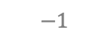
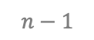
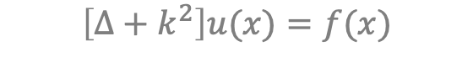
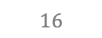
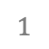
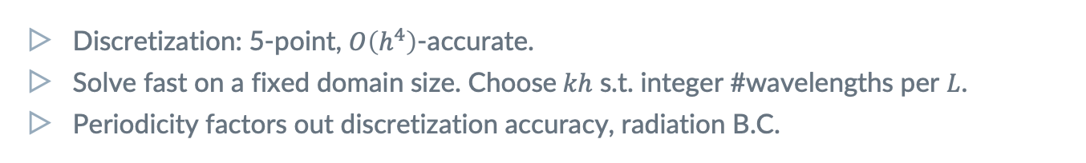
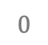
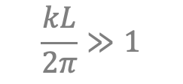
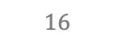
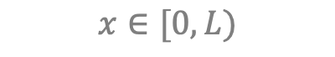
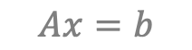
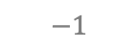
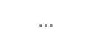
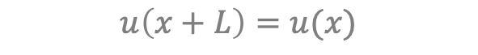
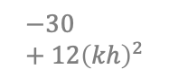
Model Problem: 1D Helmholtz
$$\frac{kL}{2π}≫1$$
$$\left[∆+k^{2}\right]u(x)=f(x)$$
$$x∈[0,L)$$
$$u\left(x+L\right)=u(x)$$
$$0$$
$$1$$
$$…$$
$$n−1$$
$$Ax=b$$
$$−1$$
$$16$$
$$−30+12{\left(kh\right)}^{2}$$
$$16$$
$$−1$$
Discretization: 5-point, $O\left(h^{4}\right)$-accurate.
Solve fast on a fixed domain size. Choose$kh$ s.t. integer #wavelengths per $L$.
Periodicity factors out discretization accuracy, radiation B.C.

Slide 9
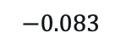
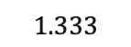
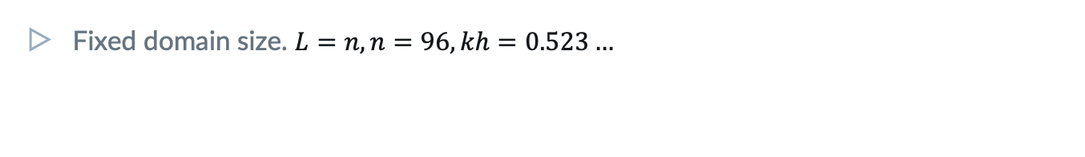
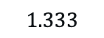
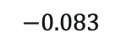
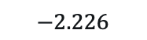
Model Problem: 1D Helmholtz
$$\frac{kL}{2π}≫1$$
$$\left[∆+k^{2}\right]u(x)=f(x)$$
$$x∈[0,L)$$
$$u\left(x+L\right)=u(x)$$
$$0$$
$$1$$
$$…$$
$$n−1$$
$$Ax=b$$
$$−0.083$$
$$1.333$$
$$−2.226$$
$$1.333$$
$$−0.083$$
Fixed domain size. $L=n, n=96, kh=0.523…$
Repetitiveness
We exploit the equations’ repetitiveness for simplicity & eyeing upscaling.

Slide 10
1. Relaxation
should exhibit a fast initial residual reduction,
starting from a random initial guess.

Slide 11
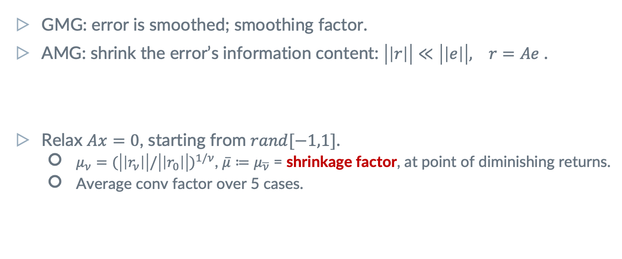
Assessing Relaxation: Shrinkage Factor
GMG: error is smoothed; smoothing factor.
AMG: shrink the error’s information content: $\left|\left|r\right|\right|≪\left|\left|e\right|\right|, r=Ae$ .
Relax $Ax=0$, starting from $rand[−1,1]$.
$μ_{ν}=(\left|\left|r_{ν}\right|\right|/{\left|\left|r_{0}\right|\right|)}^{1/ν}$, $\overline{μ}≔μ_{\overline{ν}}$ = shrinkage factor, at point of diminishing returns.
Average conv factor over 5 cases.
Appropriate norm
is required for distributive relaxation.
Use symmetry!
For a symmetric problem, prefer a symmetric relaxation scheme.

Slide 12
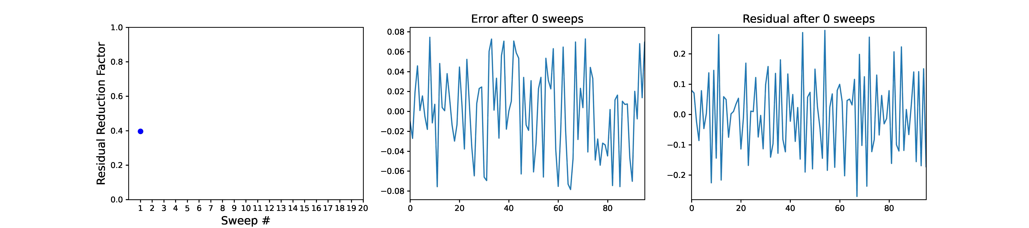
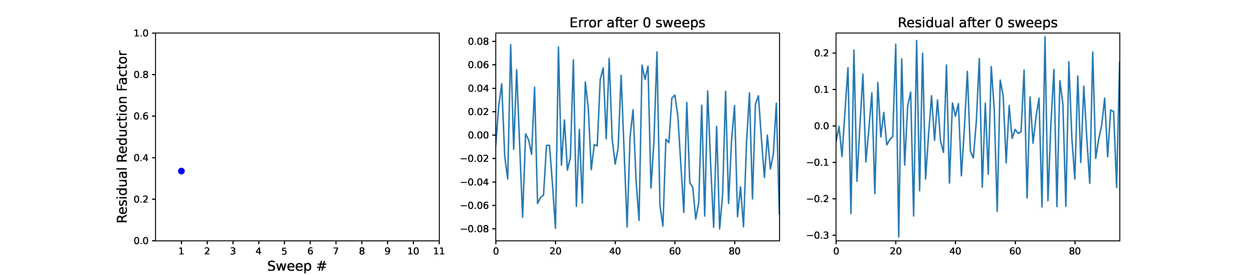
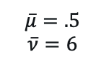
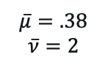
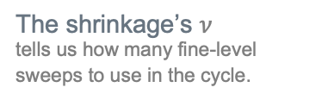
Shrinkage Factor In Action
The shrinkage’s $ν$
tells us how many fine-level sweeps to use in the cycle.
Laplace
GS
$$\overline{μ}=.5$$
$$\overline{ν}=6$$
Helmholtz
Kaczmarz
$$\overline{μ}=.38$$
$$\overline{ν}=2$$
12

Slide 13
2. Test Functions
are examples of slowly-converging errors,
which reveal connection strength between variables.

Slide 14
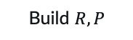
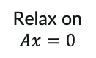
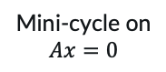
Test Functions (TFs)
Examples of slowly converging errors.
Finding Neighborhoods
Neighbors are highly correlated across TFs.
May be very different from strong coupling.
Bootstrap
Improve TFs while adding levels.
In non-linear systems,
can still produce such examples.
Separating species of vars
is important in systems.
Near null-space functions
If exist, are eventually revealed as slow-to-converge functions in the cycle.
Build $R, P$
Cycle
TFs
Relax on $Ax=0$
Random starts
Mini-cycle on $Ax=0$
Notes:
Examples can be constructed also in non-linear systems.

Slide 15
3. SVD Coarsening
reveals the right type of coarse variables, and guides the choice of coarsening ratio.

Slide 16
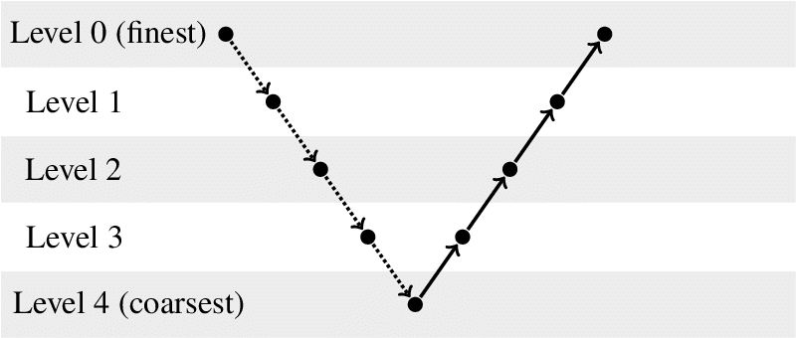
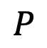
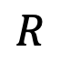
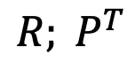
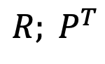
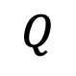
Quick Notation
Coarsening: the definition of coarse variables.
Interpolation: transfer coarse vector to fine level.
Restriction: transfer fine vector to coarse level.
For instance,
$${R; P}^{T}$$
$$R$$
$$P$$
$$Q$$
For instance,
$${R; P}^{T}$$

Slide 17
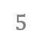
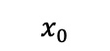













Sample Windows from single TF
$$X$$
$$=UΣV^{T}$$
$$a$$
$$x_{0}$$
$$x_{1}$$
$$s$$
$$x_{2}$$
$$…$$
$$0$$
$$1$$
$$2$$
$$3$$
$$4$$
$$5$$
$$…$$
$$n−1$$
Windows of size $a$, stride = $1$.
More samples is better, but $s≈2a$ is sufficient.
Coarse variables $R_{n_{c}×a}$= $n_{c}$ principal components of $X$.
Multiple coarse vars per aggregate.
As in SA interpolation.
Repetitive case: tile $R$
From aggregate to entire domain.
Non-repetitive case:
Generate multiple TFs.
Notes:
Principal components = first n_c rows of V^T.

Slide 18


SVD Coarsening in Action: Agg Size $=4$
18
Notes:
Note: for symmetric Kaczmarz I am getting asymmetry in the values of R[0] just like for non-symmetric Kaczmarz. James mentioned they got symmetric for symmetric Kaczmarz.

Slide 19



SVD Coarsening in Action: Agg Size $=6$
$n_{c}$ = # coarse variable species.
Helmholtz: $n_{c}=2$ is natural: cos/sin, left/right waves.
19

Slide 20




How to choose $n_{c}$ = #components?
SVD is best rank-$n_{c}$ Frobenius approximation.
Unexplained variance = relative interpolation error
For Laplace, $R$is piecewise constant, so error can be large!
$||X−XR^{T}R|{\left.​\right|}_{2}$
$${\text{(}\sum_{i≥n_{c}}{σ_{i}^{2}}/\sum_{i}{σ_{i}^{2}})}^{1/2}$$
Use SVD only to provide tentative values of coarsening ratios.
The actual number of components to be determined by the quantitative predictor of cycle convergence.

Slide 21
4. Quantitative Quality Prediction
allows designing each multilevel component separately and reliably (coarsening & cycle).

Slide 22


Mock Cycle: Predictor of 2-level Convergence
Start with random ${x=x}_{0}$.
$\text{MockCycle}\left(R, ν\right):$
Relax $ν$ times.
Update $x$ such that $Rx=Rx_{0}.$
Direct solver/Kaczmarz
To project.
$$x←x−R^{T}{\left(RR^{T}\right)}^{−1}R(x−x_{0})$$
Use Mock Cycle asymptotic convergence factor as the ultimate coarsening quality test.
Determines the optimal aggregate size, #components. Generalizes LFA.

Slide 23

Mock Cycle in Action: Convergence
 | $$ν=1$$ | $$2$$ | $$3$$ | $$4$$ | $$5$$ | $$6$$ | $$7$$ | Energy error
4/2 | .49 | .29 | .18 | .12 | .088 | .056 | .054 | .025
6/3 | .52 | .29 | .18 | .12 | .098 | .078 | .064 | .013
6/2 | .84 | .67 | .62 | .53 | .45 | .37 | .33 | .080

Slide 24



Mock Cycle in Action: Efficiency
 | $$ν=1$$ | $$2$$ | $$3$$ | $$4$$ | $$5$$ | $$6$$ | $$7$$ | Energy error
4/2 | .73 | .73 | .74 | .76 | .79 | .80 | .82 | .025
6/3 | .72 | .73 | .75 | .77 | .79 | .81 | .83 | .013
6/2 | .89 | .89 | .90 | .90 | .90 | .90 | .90 | .080
Guides the coarsening $R$.
Compare different choices. Reduction per relaxation sweep $≈$ smoothing rate, up to accuracy limit.
Generalizes LFA.
Quantitative numerical predictors > theory.
Guides the interpolation $P$.
2-level rates should attain mock cycle rates.
Prefer small aggregate size.
Aggressive coarsening can be too ambitious.

Slide 25
5. Interpolation
is constructed to accurately reproduce TFs, but tested via two-level cycle rates.

Slide 26








Ridge Least-Squares Fitting to TFs
$$0$$
$$1$$
$$2$$
$$3$$
Caliber =
2
4
$$P=R^{T}$$
$$\min_{p_{i}}{\sum_{s}{W_{is}{\left(x_{is}−\sum_{j}{p_{ij}x_{js}^{c}}\right)}^{2}}+α\sum_{s}{{\left(x_{is}\right)}^{2}}}$$
${i=0..a−1; x}^{c}=Rx$.
Weighting $W_{is}={\left|\left|r_{is}\right|\right|}^{−2} ,$local norm; unimportant for comparable TFs.
$α$ determined by minimizing interpolation error on validation samples. (Use SVD!)
$P_{a×?}$ tiled from aggregate to domain; stride = $2$ is possible, but $4$ is easier.
Notes:
As in BAMG.
Solve LS problem using SVD: reused for efficient $α$search.

Slide 27



Mock cycle predicts 2-level well
 | $$ν=1$$ | $$2$$ | $$3$$ | $$4$$ | $$5$$ | $$6$$ | $$7$$ | Fill-in | $$|A−A^{T}|$$
4/2 | .49 | .29 | .18 | .12 | .09 | .06 | .05 | - | -
$$RAR^{T}$$ | .58 | .46 | .41 | .37 | .36 | .32 | .32 | 1.2 | 0
$$RAP$$ | .51 | .28 | .17 | .12 | .09 | .07 | .06 | 1.2 | 0.0046
$$P^{T}AP$$ | .52 | .27 | .14 | .09 | .07 | .05 | .04 | 2.0 | 0
$P$: caliber 4
$ν=30$
2-level rates guide the choice of $P$.
TF reconstruction $l_{2}$ or energy error are bad predictors.

Slide 28


Coarse-level Equations
-0.08 | 1.33 | -2.23 | 1.33 | -0.08
Wave Equation
0.20 | 0.34 | -0.17 | 0.01 | 0.20 | -0.32
-0.32 | -0.56 | 0.01 | -1.46 | 0.34 | -0.56
$$RAR^{T}$$
Ray Equations
0.15 | 0.17 | -0.03 | 0.00 | 0.15 | -0.17
-0.17 | -0.16 | 0.01 | -0.63 | 0.17 | -0.16
$$RAP$$

Slide 29


3-level is OK, but still wanting
 | $$ν=3$$ | $$4$$ | $$5$$ | $$6$$ | $$7$$ | Fill-in | $$|A−A^{T}|$$
Mock | .49 | .12 | .09 | .06 | .05 | - | -
0 -> 1 | .17 | .12 | .09 | .07 | .06 | 1.2 | 0.0046
1 -> 2 | 1.68 | .24 | .15 | .19 | .17 | 1 | 0.0147
3-level, V | .81 | .15 | .18 | .17 | .14 | - | -
$RAP, P$: caliber 4

Slide 30
6. Bootstrap
Improves and reveals test functions as more levels are gradually added to the multilevel solver.

Slide 31






Save Setup Cost by Switching $Q$’s
$$Ae=r$$
$$QAPe^{c}=Qr$$
$$APe^{c}=r$$
Smooth TFs more efficiently by mini-cycles with $P=R^{T}$ to obtain high-order $P$.
Temporarily work with expensive, accurate operator for 2-level bootstrapping ($A^{c}=P^{T}AP$).
Post-processing:
Sparsify: $A^{c}=RAP$.
Symmetrize $A^{c}$.
AMG+ uses $R$!
For the first time, $R$is not just a prediction tool (mock cycle), but used in bootstrap & solver.
Notes:
We are free to switch between different Q’s during setup.

Slide 32



Mini-Cycle Shrinkage in Action
Kaczmarz
2-level Cycle(2,2;4)
Mini-cycle shrinks
more efficiently than relaxation, even if asymptotically slow.
$\overline{μ}=.58$
$\overline{ν}=6$
$\overline{μ}=.04$
${\overline{μ}}^{1/W}=.38$
$\overline{ν}=1$
32

Slide 33

Setup Work
$O\left({(a}^{3}+aν\right)n)$, dominated by SVD work.
Small of smoothing amount for R
More needed for P -> maybe need bootstrap.

Slide 34
7. Coarse-level Construction is Local,
which is especially useful for repetitive problems & upscaling.

Slide 35


Coarse-level Construction is Local (**In Principle)
Relaxation is local, so producing TFs is local.
In repetitive problems, sample across the domain.
Mock cycle rate well estimated on domain size = $4 × \text{aggregate}\text{_}\text{size}$.
Two-level cycle rate well estimated on domain size = $4 × \text{aggregate}\text{_}\text{size}$.
Exploit repetitiveness!
Sample across the (local) domain.
Tile $R, P$ of a single aggregate.
In graph problems,
define domain as a graph neighborhood of a node.
Notes:
Examples can be constructed also in non-linear systems.

Slide 36

Systematic Upscaling (WIP)
Phase 1:
Take a large enough, fixed size domain.
Derive all levels’ $R, P$, operators.
Tile & use them on a larger domain.
Phase 2:
Double domain size on every coarsening stage.

Slide 37

Recap of AMG+ Principles
Relaxation should have good shrinkage.
Test Functions (TFs) are used to construct coarsening & interpolation and.
Coarse-level variables are obtained by local TF SVD and tested by the mock cycle.
Quantitative quality prediction tools, e.g., the mock cycle, guide the separate design of each multigrid component.
Interpolation is constructed by least-squares fitting of TF values, but ultimately tested via 2-level cycle.
TFs & cycle are iteratively improve each other via bootstrap.
Coarse-level construction is a local process and can naturally support upscaling.

Slide 38
Thanks!
Questions/Ideas for Applications?
Twitter
#AMG+
Email us at
achibr@gmail.com
oren.livne@gmail.com
jjb23@psu.edu
kkahl@uni-wuppertal.de

Slide 39
EXTRA SLIDES

